Slide 1





Slide 2


Enhancing Lung Cancer Prediction Using Machine Learning: A Comparative Analysis of Hyperparameter Optimization Techniques
Hyperparameter Tuning for Lung Cancer ML
Author/Co-authors
Luxshi Karunakaran
Chandrika Malkanthi
Senthan Prasanth
R. M. K. T. Rathnayaka
Presenter: K. Luxshi
1

Slide 3
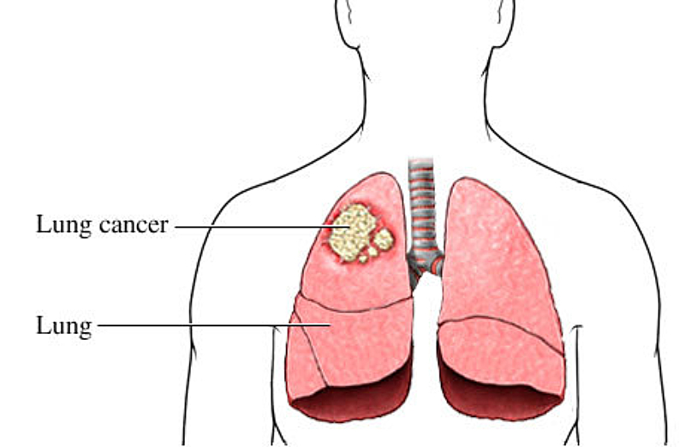

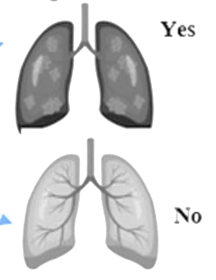
CONTENTS
Introduction
Literature Review
Methodology
Results and Findings
Conclusion
Future work
References
2

Slide 4
INTRODUCTION
Background/Problem Statement
Lung cancer is a leading global cause of death due to delayed diagnosis, which significantly lowers survival rates [1].
Conventional diagnostic methods like biopsies and CT scans are expensive, time-consuming, and susceptible to human error, limiting their accessibility [2].
Machine learning and deep learning models provide a cost-effective, automated approach to predict lung cancer using numerical patient data.
There is a critical need to evaluate how hyperparameter tuning and cross-validation techniques enhance the performance of these models for accurate diagnosis.
3

Slide 5
LITERATURE REVIEW
Table 1: Existing studies of lung cancer prediction
Ref | Title/Study Focus | Techniques Used | Key Findings
[1] | DL models for lung cancer detection | CNN, MobileNet, Swin Transformer, ANN, Radiomics, U-Net | CNNs (AUC = 0.90), Swin captures long-range dependencies; MobileNet is efficient.
[3] | Rise of ML/DL in lung cancer prediction | ML and DL methods | ML/DL have rapidly advanced over the last decade.
[4] | SVM and RF vs traditional learning | SVM, Random Forest | SVM and RF surpass traditional models using engineered features.
4

Slide 6
LITERATURE REVIEW
Ref | Title/Study Focus | Techniques Used | Key Findings
[5] | Classification using ensemble and radiomic features | GNB, SVM, LR, RF, Gradient Boosting, XGBoost, Radiomics, CNN | Ensemble models showed high accuracy; CNN reached AUC of 0.90.
[6] | Histopathology with DL and ensemble learning | ResNet-50, VGG-16, EfficientNet-B5, U-Net, Ensemble | Ensemble best (accuracy 0.99); EfficientNet-B5 scored 0.97.
[7] | Lung cancer incidence forecasting in Europe | SVR, LSTM, Backpropagation | SVR outperformed others (best in MSE, R², EV); LSTM lowest performance.
5

Slide 7
LITERATURE REVIEW
Ref | Title/Study Focus | Techniques Used | Key Findings
[8] | Hyperparameter tuning and hybrid feature extraction | GLCM, Haralick, Autoencoder, SVM (RBF, Gaussian, Poly), Stratified/LOO CV | SVM with hybrid features improved accuracy; CV ensured robustness.
[9] | Boosting models comparison | XGBoost, LightGBM, AdaBoost, Logistic Regression, SVM | XGBoost: best accuracy (97.5%), LightGBM strong alternative.
[10] | Transformer model limitations | Transformer | High computational complexity; not suitable for low-resource settings.
6

Slide 8
Research Gap
Existing research primarily focuses on image-based lung cancer prediction (e.g., CT scans), with insufficient evaluation of numerical patient data, limiting accessibility in low-resource settings.
There is a lack of comprehensive studies on how hyperparameter tuning impacts the performance of machine learning and deep learning models for lung cancer prediction.
Current studies often neglect robust cross-validation methods like stratified k-fold or leave-one-out, which are critical for ensuring model reliability and reducing overfitting.
There is a gap in integrating these models into clinical workflows, particularly addressing computational efficiency and real-world applicability for diverse patient populations.
7

Slide 9
Main Objective
Build an accurate, accessible lung cancer prediction model using numerical patient data. Optimize ML and DL techniques for early detection. Reduce reliance on costly imaging for affordability.
Sub-Objectives
Assess ML and DL models with accuracy, sensitivity, specificity, and ROC-AUC metrics. Identify the most reliable algorithm. Ensure precision for medical use.
Tune hyperparameters to boost model accuracy. Use cross-validation to prevent overfitting. Ensure generalizability across diverse datasets.
Develop a cost-effective model using numerical data. Minimize imaging dependency for broader access. Enable early diagnosis in resource-limited settings.
8

Slide 10
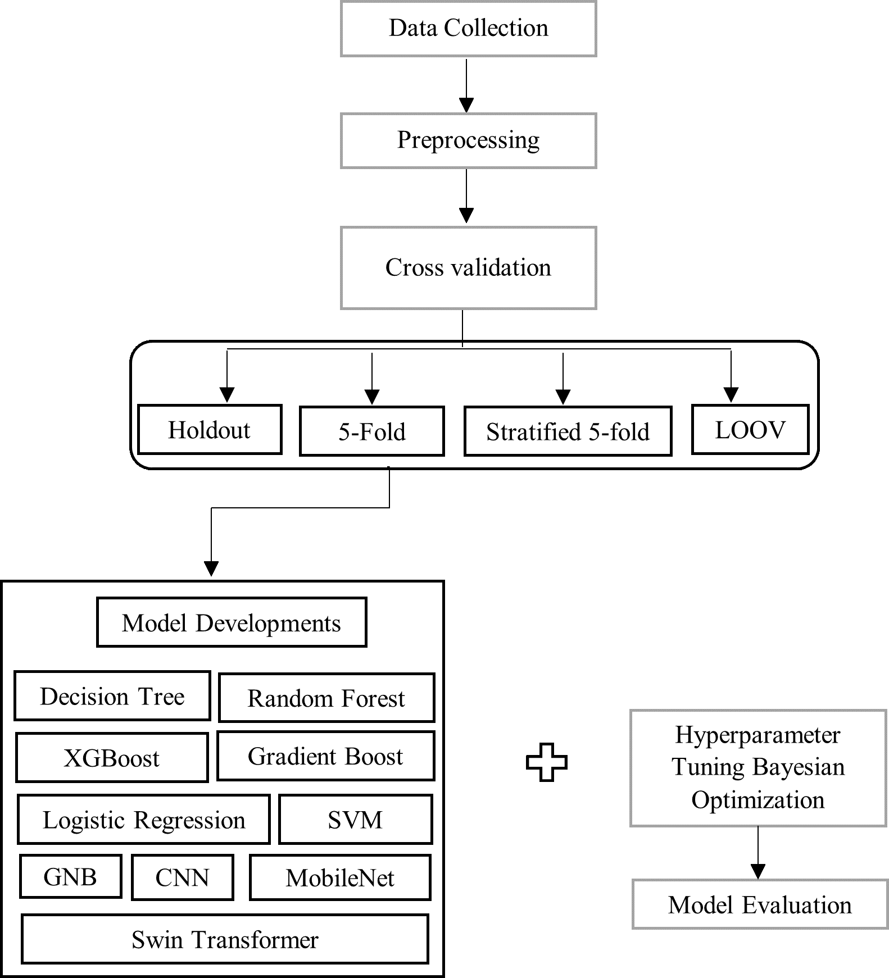
METHODOLOGY
The dataset collected from Kaggle public dataset and involves the creation of a lung cancer prediction system using comprehensive analysis of hyperparameters and cross-validation methods through ML and DL models.
Fig 1. High level architecture
9

Slide 11
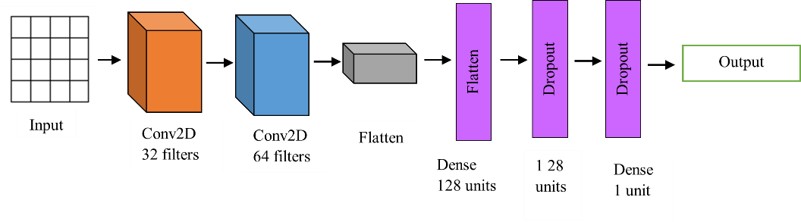
METHODOLOGY
DL model architecture
Fig 2. CNN architecture
10

Slide 12
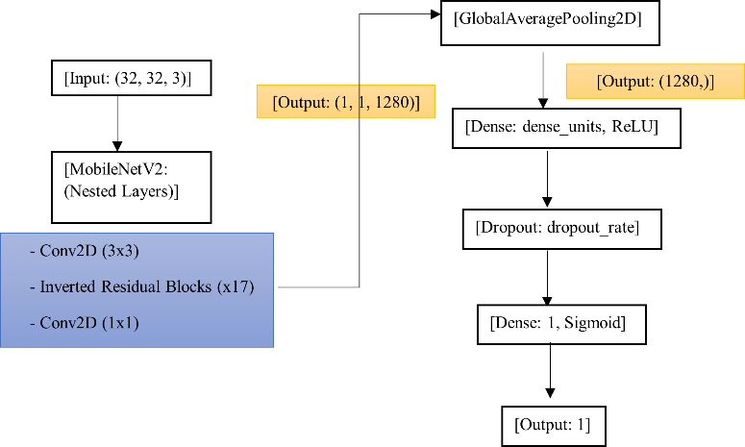
METHODOLOGY
DL model architecture
Fig 3. MobileNet architecture
11

Slide 13
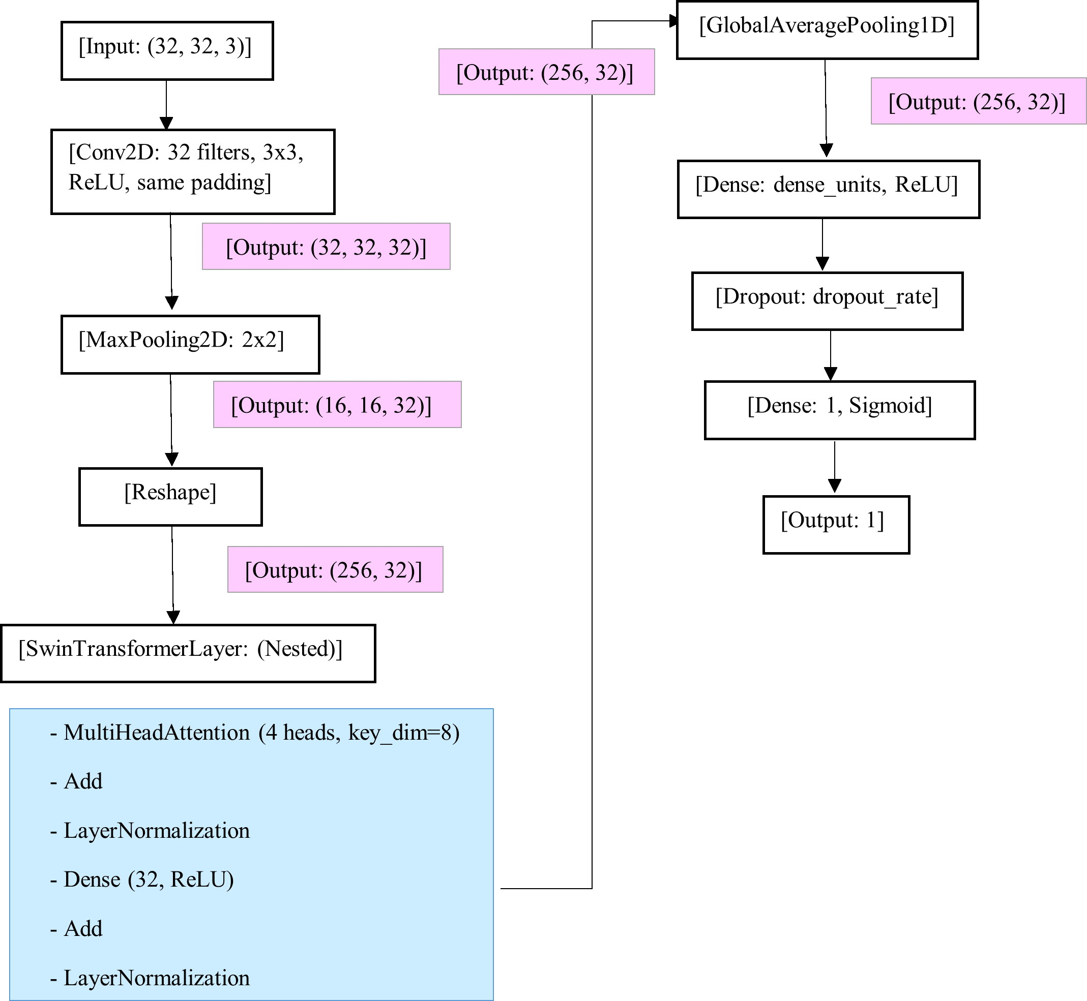
METHODOLOGY
DL model architecture
Fig 4. Swin Transformer architecture
12

Slide 14
RESULTS
Table 2: Results of cross validations without using Bayesian optimization
No | Model | K-fold method | Stratified K-fold | Leave-one-out
1 | GNB | 0.9097 | 0.9097 | 0.9069
2 | SVM | 0.9772 | 0.9772 | 0.9821
3 | Logistic Regression | 0.9456 | 0.9456 | 0.9461
4 | Decision Tree | 0.9957 | 0.9957 | 0.9968
5 | Random Forest | 0.9961 | 0.9957 | 0.9967
6 | Gradient Boosting | 0.9833 | 0.9833 | 0.9842
7 | XGBoost | 0.9961 | 0.9961 | 0.9968
8 | CNN | 0.9870 | 0.9870 | 0.9870
9 | Mobile Net | 0.9778 | 0.9778 | 0.9778
10 | Swin Transformer | 0.9418 | 0.9418 | 0.9418
13

Slide 15
RESULTS
Table 3 : Results of cross validation using Bayesian Optimization
No | Model | K-fold method | Stratified K-fold | Leave-one-out
1 | GNB | 0.9172 | 0.9172 | 0.9171
2 | SVM | 0.9961 | 0.9961 | 0.9961
3 | Logistic Regression | 0.9463 | 0.9463 | 0.9461
4 | Decision Tree | 0.9957 | 0.9957 | 0.9968
5 | Random Forest | 0.9961 | 0.9961 | 0.9968
6 | Gradient Boosting | 0.9889 | 0.9909 | 0.9870
7 | XGBoost | 0.9968 | 0.9968 | 0.9968
8 | CNN | 0.9838 | 0.9838 | 0.9838
9 | Mobile Net | 0.9902 | 0.9902 | 0.9902
10 | Swin Transformer | 0.9369 | 0.9369 | 0.9369
14

Slide 16
RESULTS
After applying Bayesian optimization, the performance of the models improved, with the ensemble models achieving the highest results.
Table 4: Model performance after hyperparameter strategies
No | Model | Training Accuracy | Testing Accuracy | Training Time (s)
1 | GNB | 0.9148 | 0.9150 | 0.36
2 | SVM | 0.9968 | 0.9961 | 510.02
3 | Logistic Regression | 0.9469 | 0.9463 | 0.33
4 | Decision Tree | 0.9968 | 0.9957 | 0.51
5 | Random Forest | 0.9968 | 0.9961 | 18.03
6 | Gradient Boosting | 0.9968 | 0.9968 | 96.22
7 | XGBoost | 0.9968 | 0.9968 | 15.41
8 | CNN | 0.9847 | 0.9838 | 13.66
9 | MobileNet | 0.9699 | 0.9762 | 98.71
10 | Swin Transfomer | 0.9369 | 0.9421 | 400.94
15

Slide 17
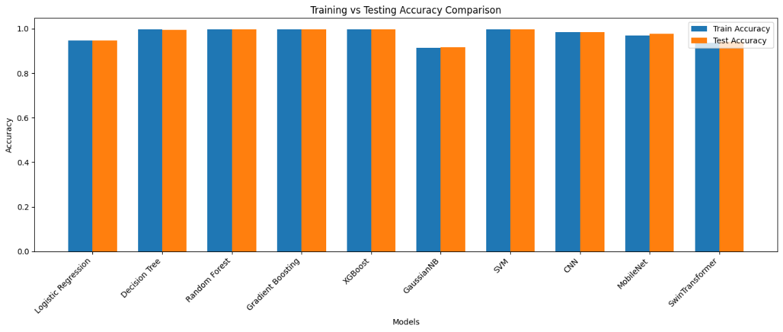
RESULTS
Fig 5: Model Comparison of Training and Testing accuracy
16

Slide 18
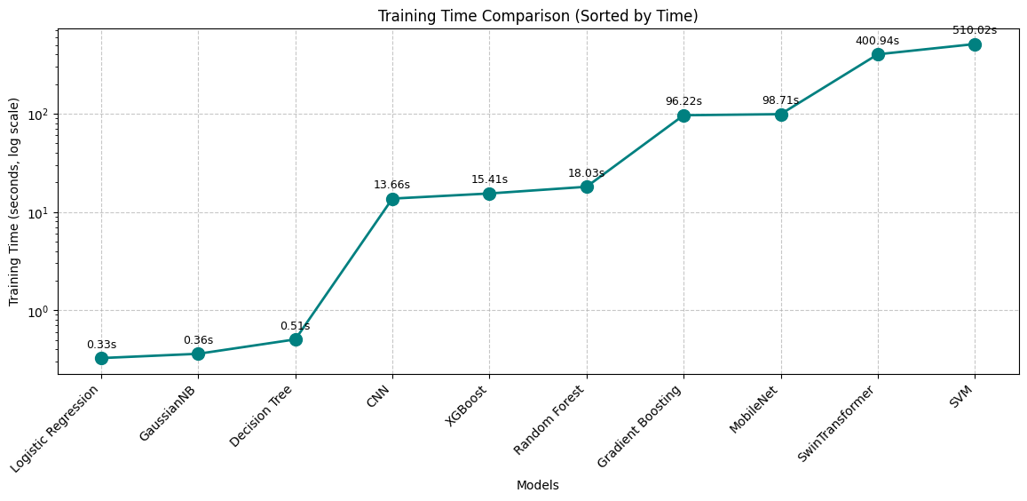
RESULTS
Fig 6: Training time of ML models
17

Slide 19
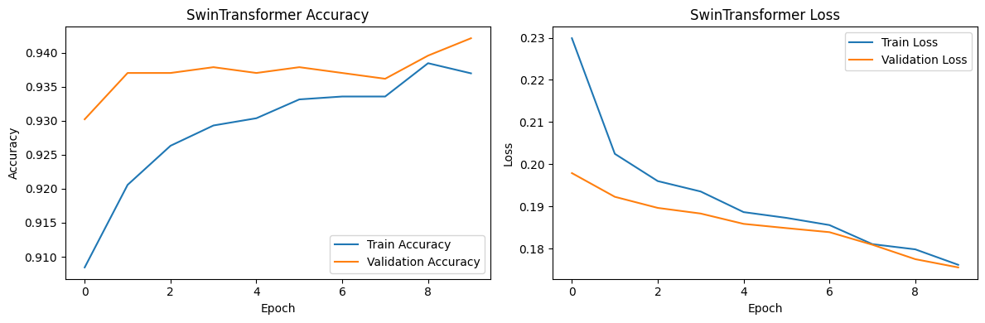
RESULTS
Fig 7: Swin Transformer model Accuracy and Loss graph
18

Slide 20
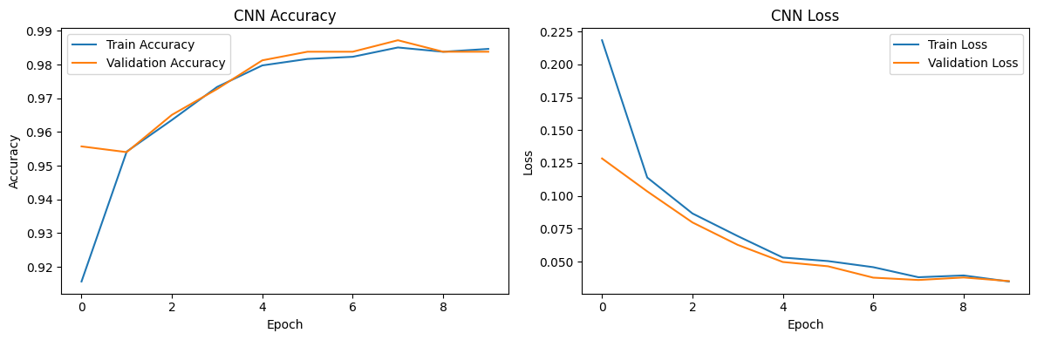
RESULTS
Fig 8: CNN model Accuracy and Loss graph
19

Slide 21
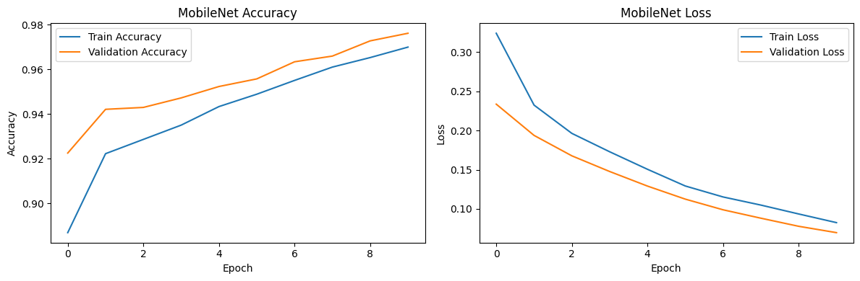
RESULTS
Fig 9: MobileNet model Accuracy and Loss graph
20

Slide 22
RESULTS
Table 5: Evaluation matric for ML and DL models (without using Bayesian Optimization)
No | Model | Specificity | Sensitivity | Precision | Recall | F1-Score
1 | GNB | 0.5486 | 0.9651 | 0.9387 | 0.9651 | 0.9517
2 | SVM | 0.9722 | 1.000 | 0.9961 | 1.000 | 0.9981
3 | Logistic Regression | 0.7569 | 0.9661 | 0.9661 | 0.9661 | 0.9661
4 | Decision Tree | 0.9722 | 1.000 | 0.9961 | 1.000 | 0.9981
5 | Random Forest | 0.9722 | 1.000 | 0.9961 | 1.000 | 0.9981
6 | Gradient Boosting | 0.9722 | 1.000 | 0.9961 | 1.000 | 0.9981
7 | XGBoost | 0.9722 | 1.000 | 0.9961 | 1.000 | 0.9981
8 | CNN | 0.9514 | 0.9922 | 0.9932 | 0.9922 | 0.9927
9 | Mobile Net | 0.8750 | 0.9942 | 0.9827 | 0.9942 | 0.9884
10 | Swin Transformer | 0.7361 | 0.9670 | 0.9633 | 0.9670 | 0.9652
21

Slide 23
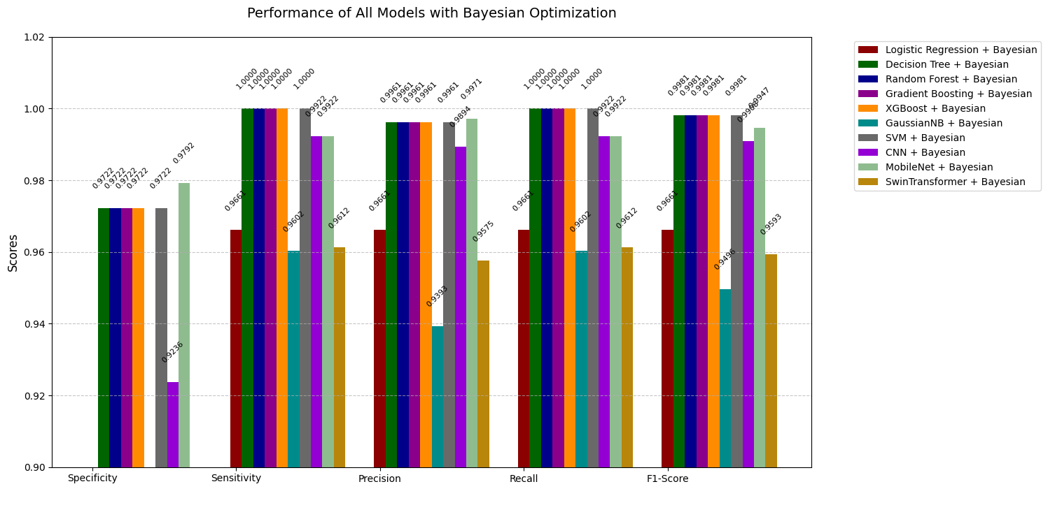
RESULTS
Fig 8: Comparison of ML and DL evaluation metrics with Bayesian optimization
22

Slide 24
CONCLUSION
The study demonstrated that ensemble models such as Decision Tree, XGBoost, Random Forest, and Gradient Boosting achieved the highest accuracy (0.9968) and perfect AUC-ROC (1.00), making them the most effective for lung cancer prediction.
Among deep learning models, CNN showed the best performance with 0.9838 accuracy and low training time, while MobileNet and Swin Transformer exhibited good results but suffered from higher training times and slight overfitting.
Bayesian hyperparameter optimization significantly improved model generalization and accuracy.
The use of stratified 5-fold cross-validation ensured balanced evaluation, especially beneficial for handling class imbalance in medical datasets.
23

Slide 25
FUTURE WORK
Improve the efficiency of Swin Transformer and MobileNet using techniques like weight decay, dropout regulation, and data augmentation.
Enhance CNN generalization in LOO cross-validation through larger datasets and transfer learning.
Evaluate model performance on resource-limited platforms (e.g., edge devices) to ensure real-world applicability.
24

Slide 26
REFERENCES
[1] | M.A. Heuvelmans et al. “Lung cancer prediction by Deep Learning to identify benign lung nodules”. In: Lung Cancer 154 (2021), pp. 1–4.
[2] | T. Kadir and F. Gleeson. “Lung cancer prediction using machine learning and advanced imaging techniques”. In: Translational Lung Cancer Research 7.3 (2018), p. 304.
[3] | CSAnitaetal. “Lung cancer prediction model using machine learning tech niques”. In: International Journal of Health Sciences II (2022), pp. 12533 12539.
[4] | S.G. Kanakaraddi, V.S. Handur, A. Jalannavar, et al. “Segmentation and classification of lung cancer using deep learning techniques”. In: Procedia Computer Science 235 (2024), pp. 3226–3235.
[5] | D.M. Abdullah, A.M. Abdulazeez, and A.B. Sallow. “Lung cancer predic tion and classification based on correlation selection method using machine learning techniques”. In: Qubahan Academic Journal 1.2 (2021), pp. 141 149.
[6] | D. Berrar. “Cross-validation”. In: Cross-validation. Editor, Eds. 2019.
[7] | Y. Chen et al. “Detection and classification of lung cancer cells using Swin Transformer”. In: Journal of Cancer Therapy 13.7 (2022), pp. 464–475.
25

Slide 27
Q & A
THANK YOU
26

